Slide 1

Console I/O

Slide 2
Writing to Console
System.out.print()
System.out.println()

Slide 3
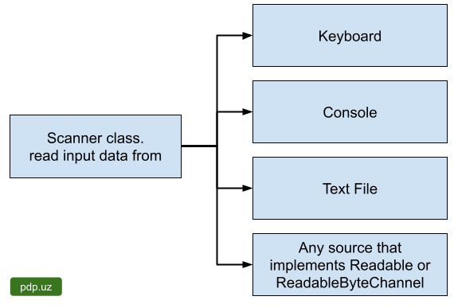
Scanner
The Scanner class is used to get user input, and it is found in the java.util package(Since 1.5).
Oracle Documentation

Slide 4
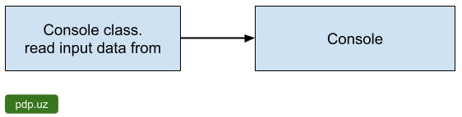
Console
To access the character-based console device, if any, associated with the current Java virtual machine(Since 1.6).
Oracle Documentation

Slide 5
The Scanner Bug
What Kind of bug you are talking about
1 | 2 | \n | Respect |  | PDP
Here is bug

